Slide 1
The F.A.A.I.R. Project

Slide 2
Related Works
Precision agriculture has allowed farmers to make data driven changes to their fields to optimize yield.
Work on weed detection was done by Hassanein et al whereby a new weed detection methodology was introduced. This methodology used a low-cost UAV system for detecting the high-density vegetation spots as indication for weed patches in various cropped agricultural fields at various flight heights.
This project’s approach on weed detection differs from Hassanein et al by implementing a pixel classification approach, our team’s goal is to produce highly accurate weed detection results for every individual weed plant.

Slide 3
Irrigation scheduling technique has become crucial for smart water usage in agriculture. Soil moisture measurements and meteorological variables are traditionally used for monitoring crop water stress by estimating the amount of water lost from a plant-soil system.
These approaches are labour intensive, destructive and unsuitable for automation.
Custom software will be built around the models to provide insights to farmers.

Slide 4
> Data Collection and Raw Materials
> Data Processing
> Model Development
> Challenges and Considerations
> A short Demo
> Future Opportunities

Slide 5

Data Collection and Raw Materials
For the application of this project a UAV was determined to be the fastest and most efficient way to data collect.
The drone ordered was outfitted with an NDVI sensor (normalized difference vegetation index). This sensor is used to measure the chlorophyll activity of the plant.

Slide 6
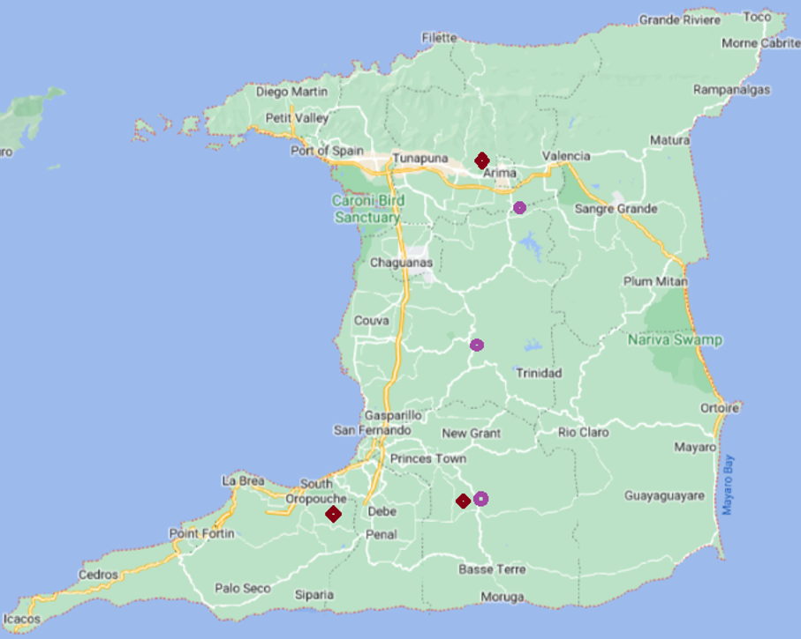
Data Collection
This project was aimed at applying some large scale agricultural techniques to Caribbean islands in spite of their unique challenges such as small scale farming while provide insights leading to increased crop yield in the face of climate change.
These plants were selected because of their life cycles, distinction, and availability.

Slide 7
Peppers & Pak Choi
The life cycle to maturity is very short.
We would be able to repeat certain parts of the experiment at least twice.

Slide 8
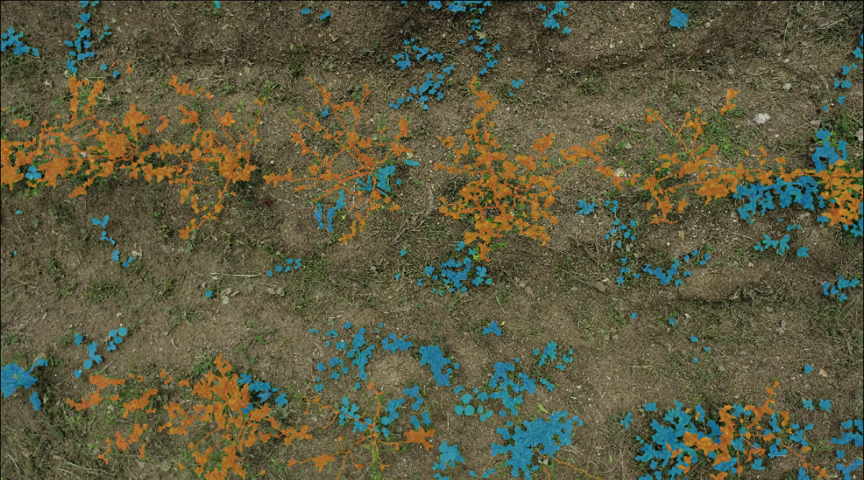
Additional Materials
In addition to the drone we also procured a water sensor for the water-stress part of the project.
For labelling Matlab and Image labeler were used to label the images.
The data was collected during peak lighting.

Slide 9
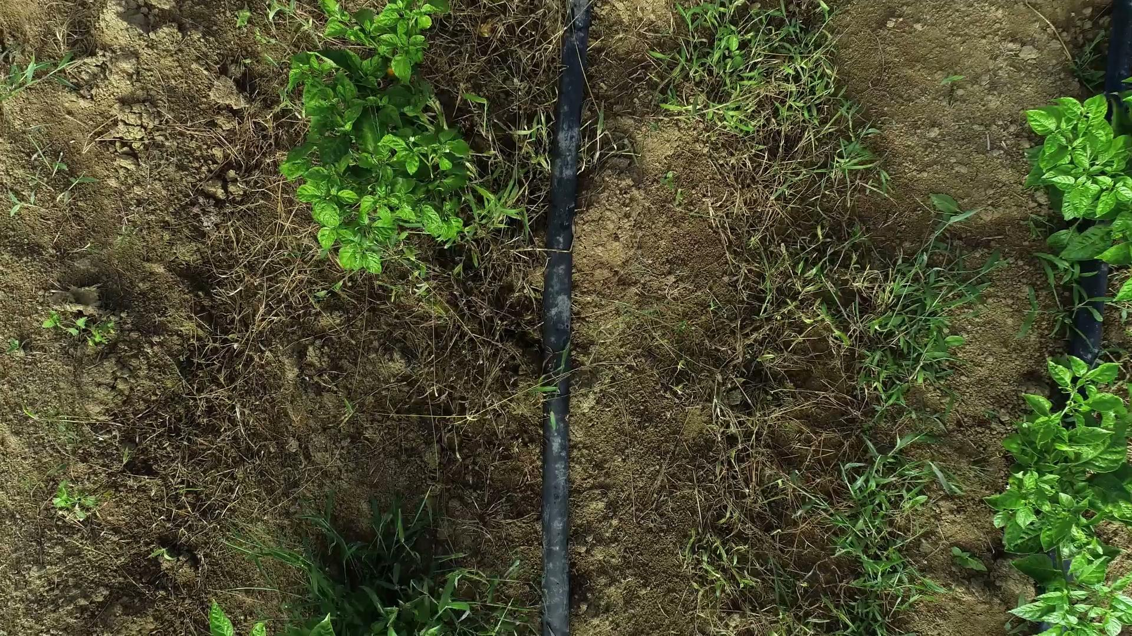
Data Processing
Data processing was simply the task of collecting the video.
Splicing the frames and determining which images were best to use for the models.
Generally we avoided blurry images, images with artifacts and images with too much overlap.
The processed images would then be labelled.
Image Labelling was done by :
Britney Peters, Mitra Sookramsingh, Sara Bernard, Shannon-Rae Hackett, Aliyah Khan, Aqeel Yasir Mohammed, Roganci Fontelera and myself.

Slide 10
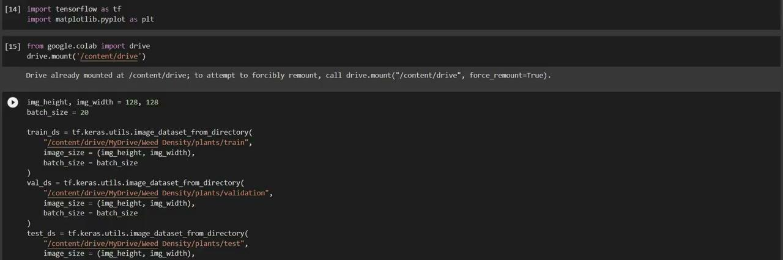
Model Development:
Water stress in plants(pakchoi)
Detect weeds and crops(peppers)
Determine weed density (peppers)
Detect damaged crops(pak choi)
Determine the developmental stages of (pak choi)

Slide 11
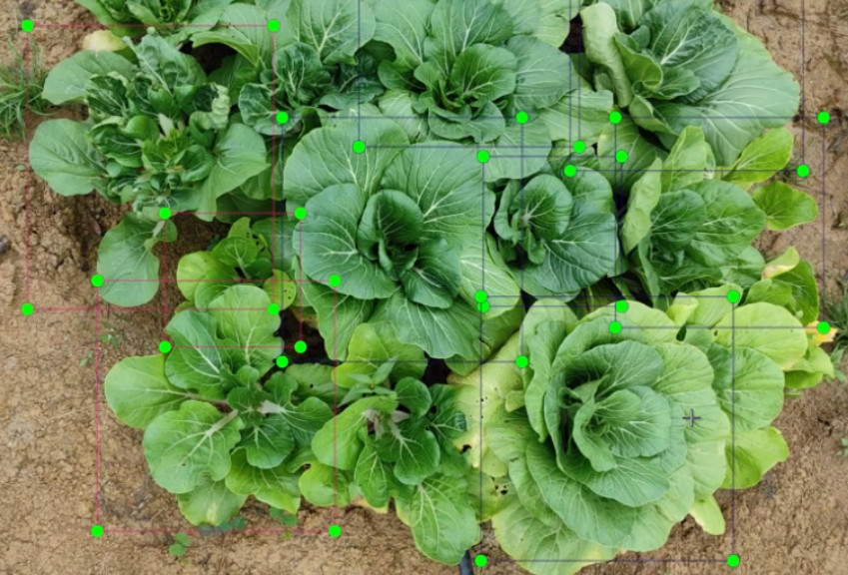
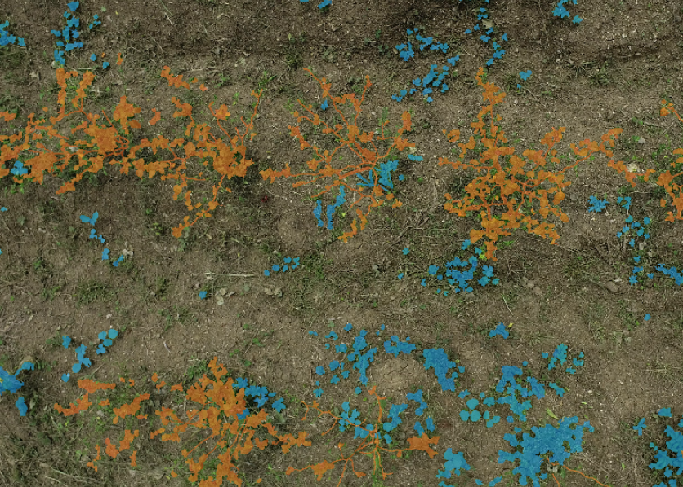
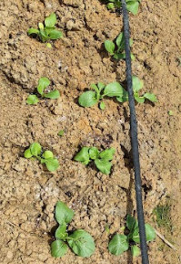
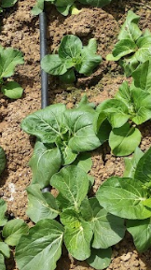
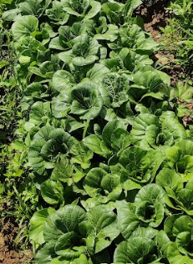
Model Development:
Binary Classification
damaged
Not damaged
Multi-Class Classification
Seedling 2-3 weeks Harvestable

Slide 12
Models Creation
Model | Accuracy
SVM | 0.48
Random Forest | 0.88
Naive Bayes | 0.32
XGBoost | 0.92
U-Net | 0.79
Seg-Net | 0.76
Deep Lab | 0.71
Overall, the best performing model for weed detection is XGBoost at 92% accuracy.
Model | Accuracy
SVM | 0.37
Random Forest | 0.70
Naive Bayes | 0.40
XGBoost | 0.76
U-Net | 0.48
For water stress detection XG Boost also performed the best at about 70% accuracy.

Slide 13
Models :
We trained numerous models and we integrated models within the built applications based on the latency, compatibility and performance.
We mainly focused on XG Boost and Mobile-Net models since Mobile-Net had consistent performance in mobile development and XG Boost was preferred for Web integration.

Slide 14
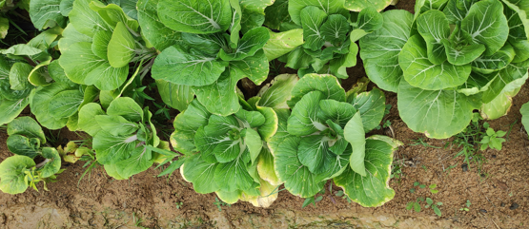
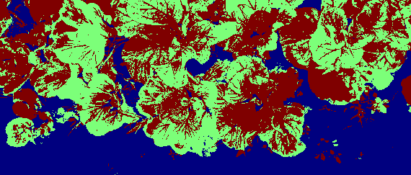


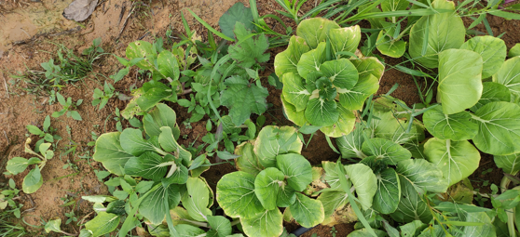
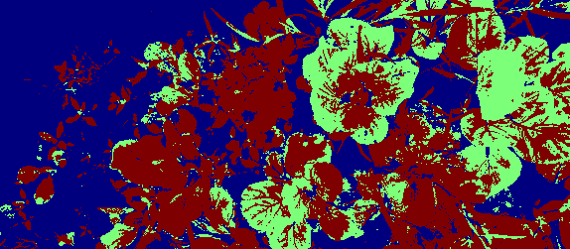
Model Segmented Predictions:
Water Stressed
Not Water-Stressed
Most of the Water-Stressed models have 60-70% accuracy. This is can be improved upon with more data.

Slide 15
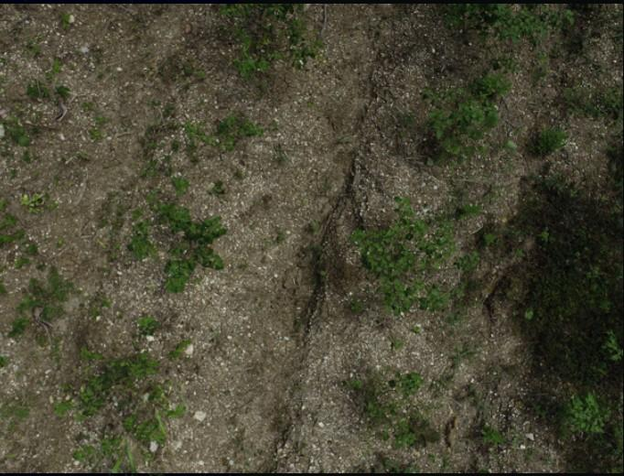
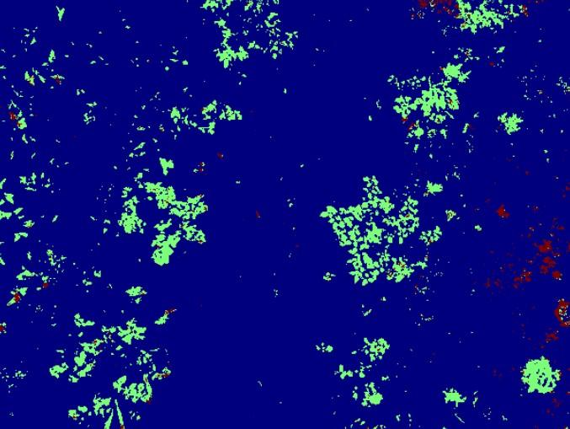
Model Segmented Predictions:
crop
weed
The weed detection models had a 70-80% accuracy. This is can be improved upon with more data.

Slide 16
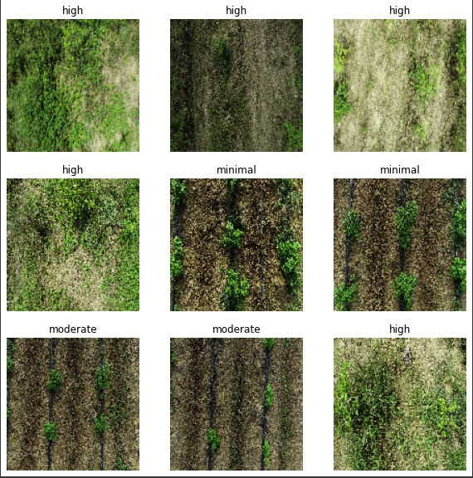
Model Predictions:
The model accuracy for Multi-class Classification is at 90% accuracy. For this model we used a Convolutional Neural Network which greatly improved the performance since there were 600 plus images in the dataset.
The Multi-Classification model for weed density performed at 75% accuracy.

Slide 17

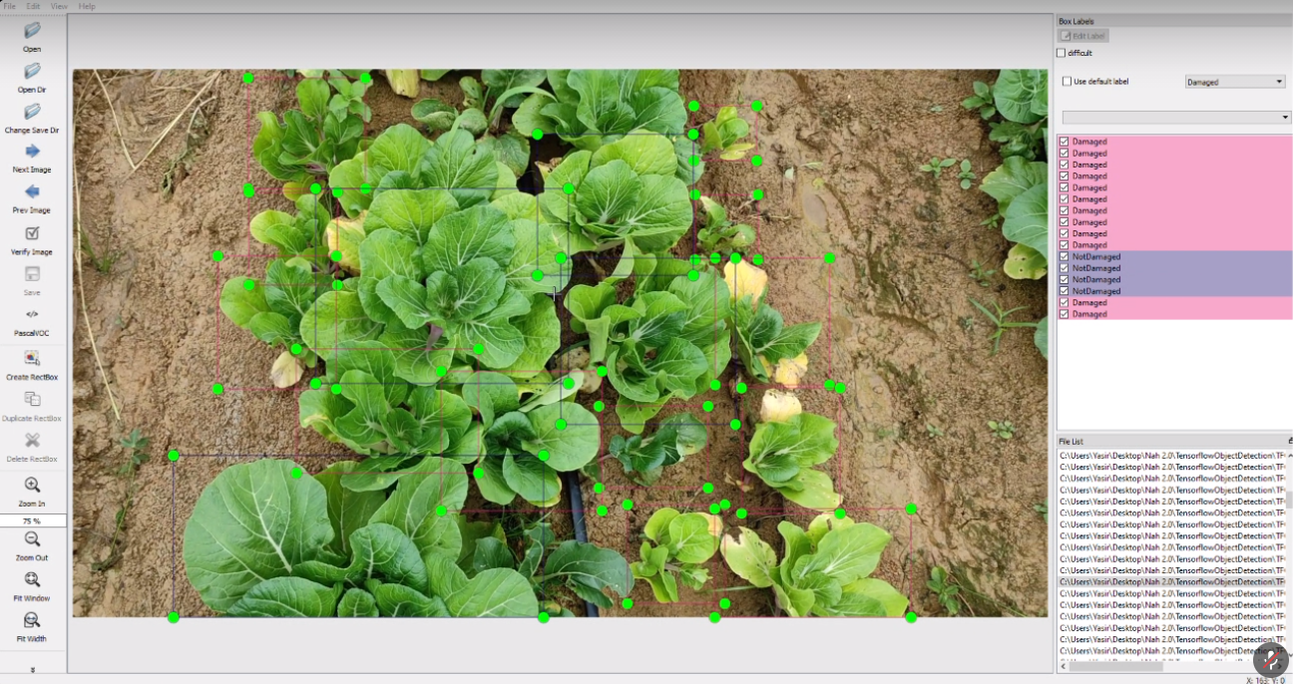
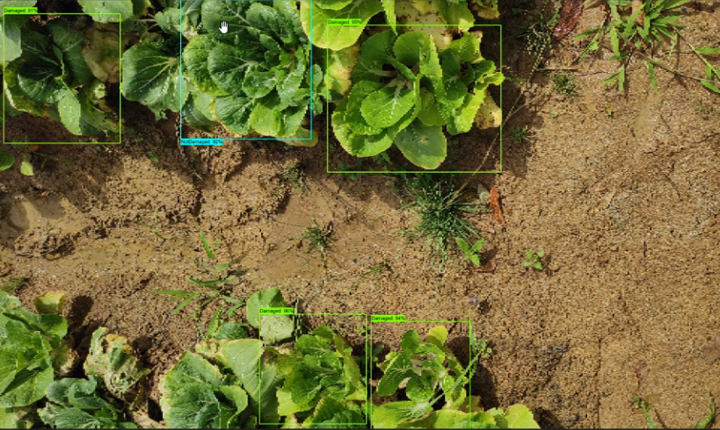
Object detection model Prediction

Slide 18
Challenges & Considerations
Data Labelling & Data Collection
Model Training
Time Constraints
Limited Human Resource

Slide 19


Vishan Chattergoon
(TTLAB Research Scientist Web App Developer)

Slide 20
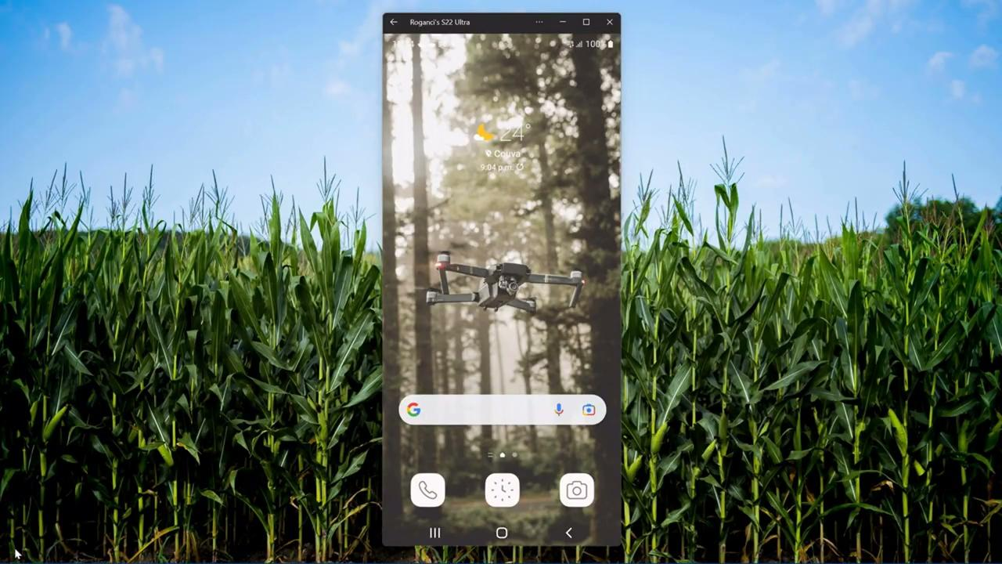
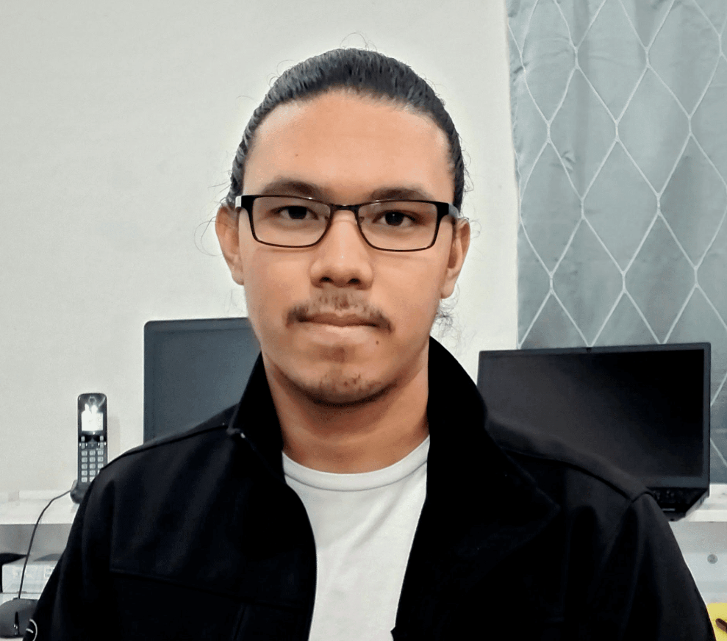
Roganci Fontelera
(TTLAB Research Scientist, Mobile App Developer)

Slide 21
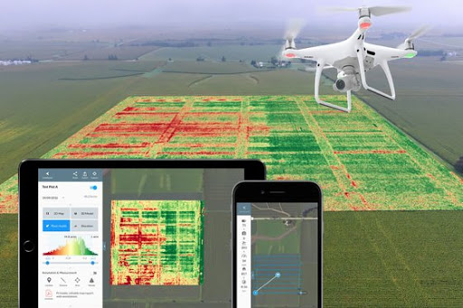
Future Opportunities
Anyone who has never made a mistake has never tried anything new. - Albert Einstein
Detect Plant Diseases
Estimate crop yields by calculating the expected yield of a crop in a specific area
Identify contaminants in crops and soils
Supporting Precision Agriculture (mention herbicide and pesticides reduction...)

Slide 22
Conclusion
Overall, the project enabled the real time and rapid assessment of smallholder crop and water stress detection using machine learning models.
By generating landscape data, reducing reliance on post-processing expertise and expensive satellite imagery, the project will increase the adoption of AI for climate smart agriculture in the Caribbean.

Slide 23
Publications
https://www.atlantis-press.com/proceedings/icosia-22
https://tinyurl.com/FFA100yrconferenceproceedings.
Open Dataset Tutorial Github Link
https://github.com/Jade98-afk/FAAIR_OpenData_Tutorial/blob/main/UsingDatasetTutorial.ipynbOpen Dataset Access Code Tutorial
TTLAB Data Sets - data.tt site

